Slide 1



Batch Element Entry (BEE)

Slide 2


Assignment Set and Element Set

Slide 3
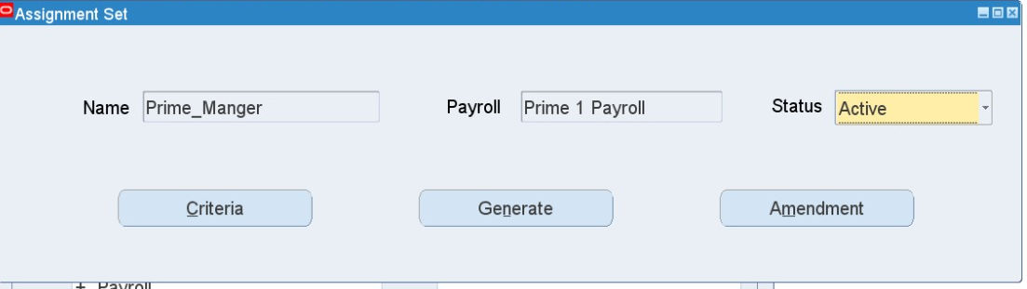
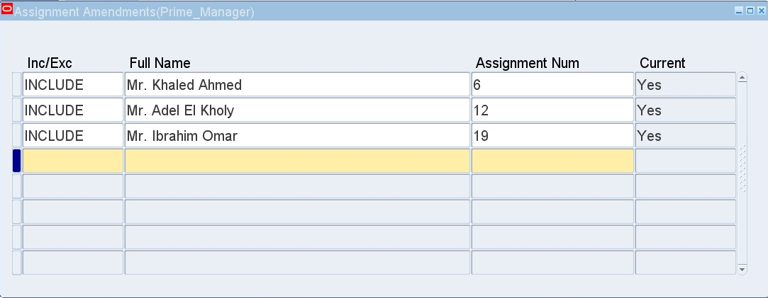

1. Assignment Set
HRMS > Payroll > Assignment Set
Add Name (no spaces)
Choose Current Payroll
Status: Active
Amendment Button: Add employees into the assignment set

Slide 4
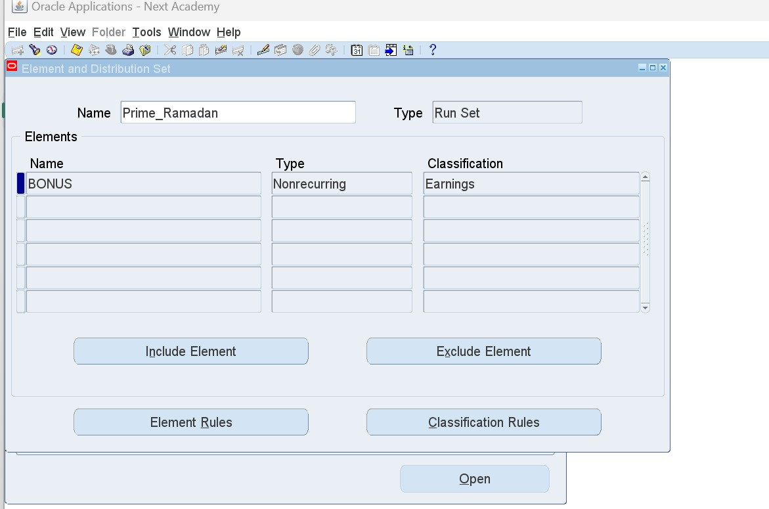
2. Element Set
HRMS > Payroll > Element Set
Include Element: Adds element to the set
Exclude Element: Removes element from the set
Classification Rules: Adds all elements based on their classification (ex. Earnings)

Slide 5
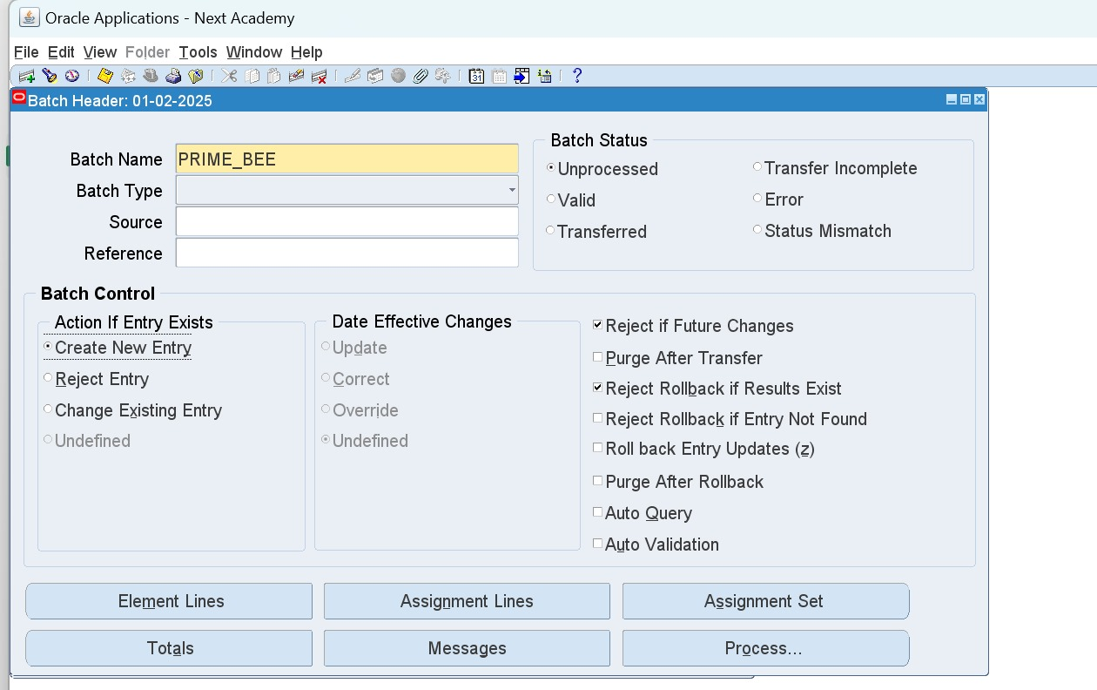
Batch Element Entry (BEE)
HRMS > Mass Information eXchange MIX > Batch Element Entry
1. Alter Date to first day of the current month
2. Batch Name (should be saved somewhere safe)

Slide 6
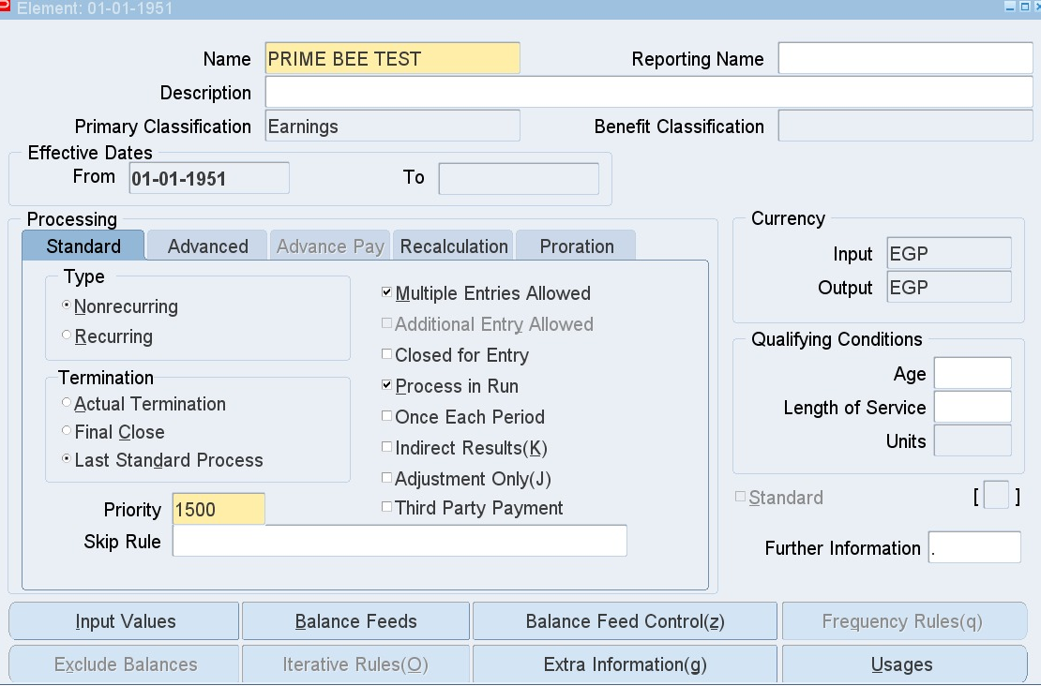
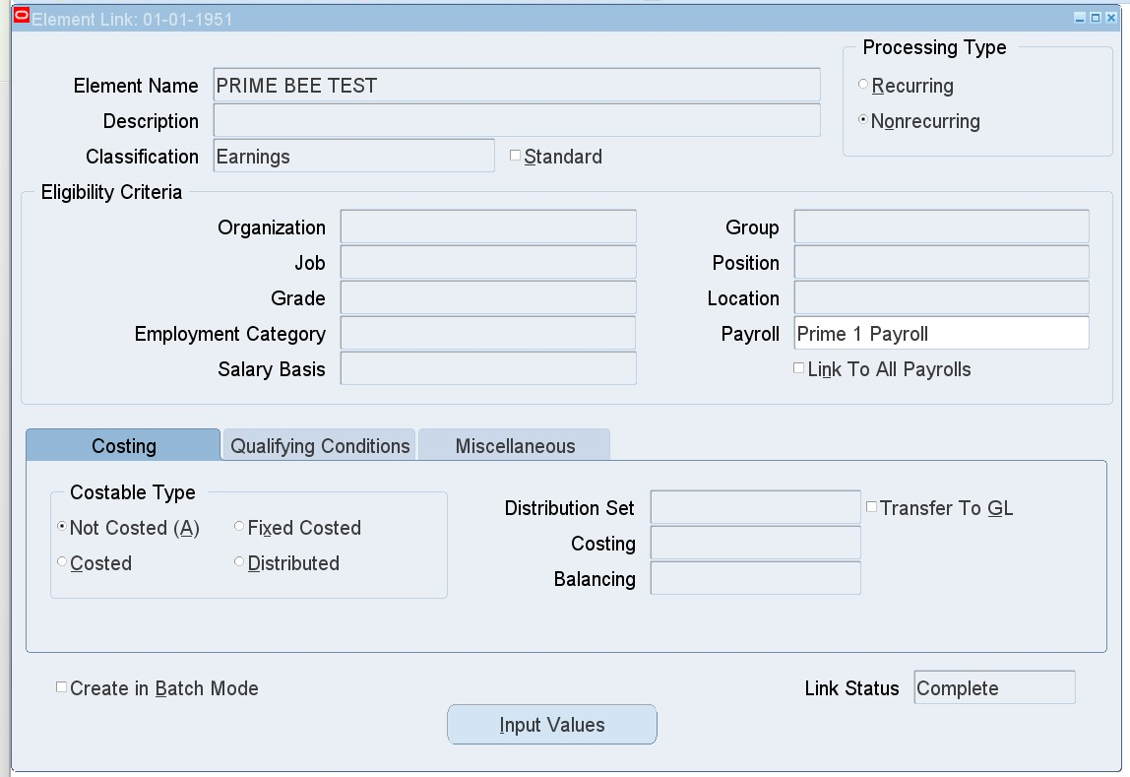
Steps to enter “One Element” (different values) to “Many Employees”
1. Create a non-recurring element and element link
HRMS > Total Compensation > Basic > Element Description
HRMS > Total Compensation > Basic > Link

Slide 7
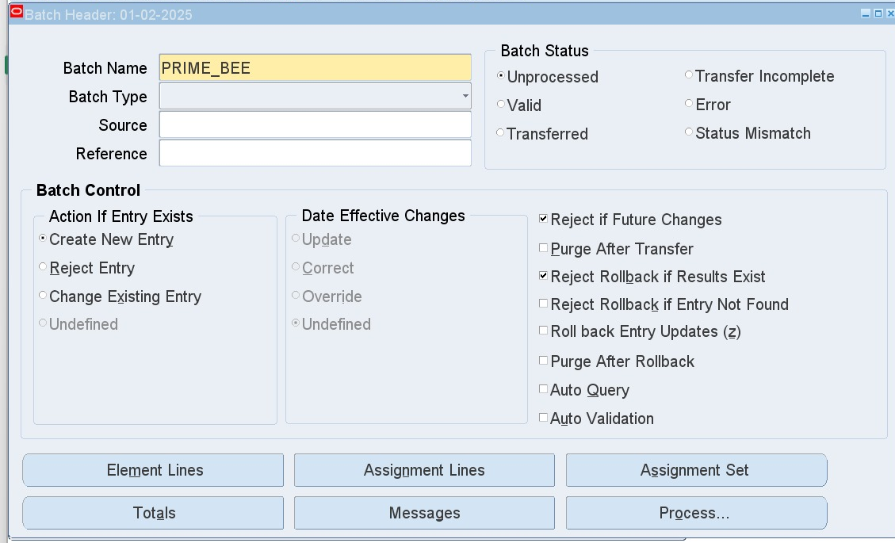
2. Create BEE
HRMS > Mass Information eXchange MIX > Batch Element Entry
Check Action:
A. Create New Entry:
Enter new element to entries (even if it already exists)
3. Press on Element Lines Button to add employees to which this element should be entered

Slide 8
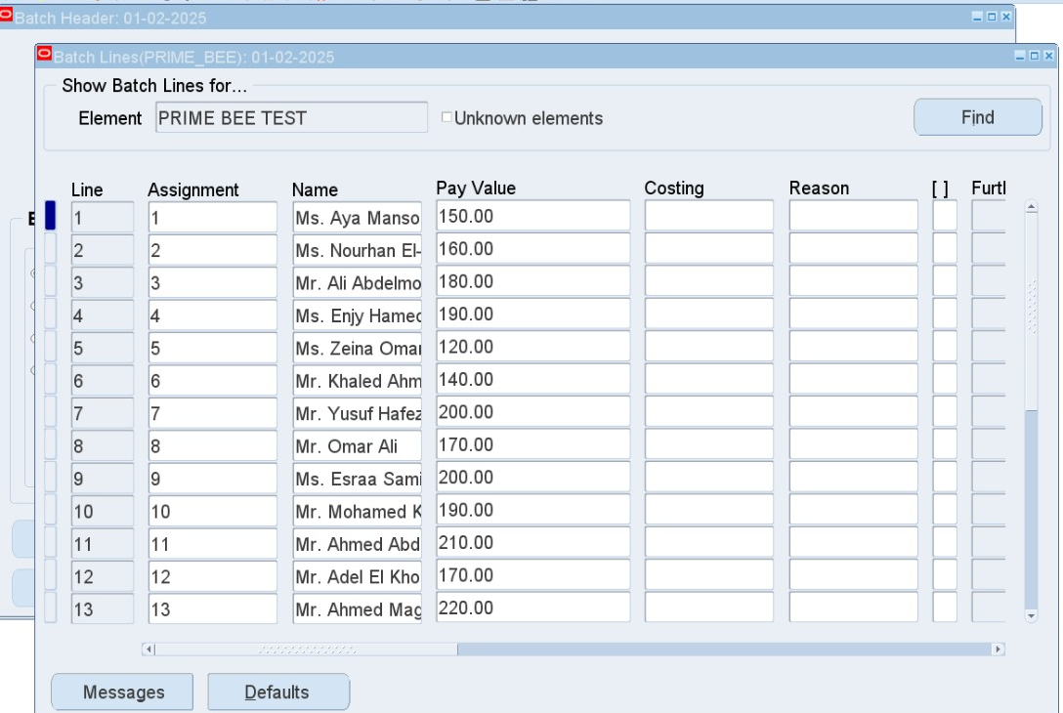
Data Loader can help here
Add the different Pay Value for each employee in Pay Value column

Slide 9
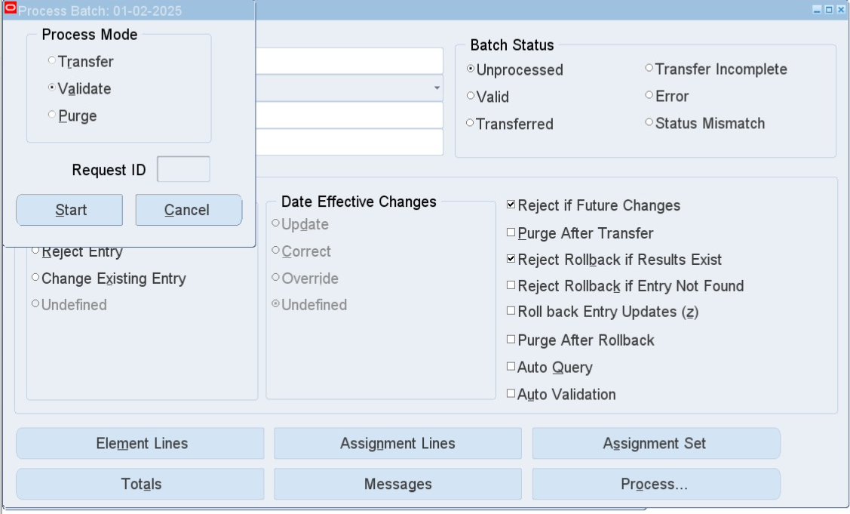
4. Process Button > Choose Validate
(Messages Button to review any errors)

Slide 10
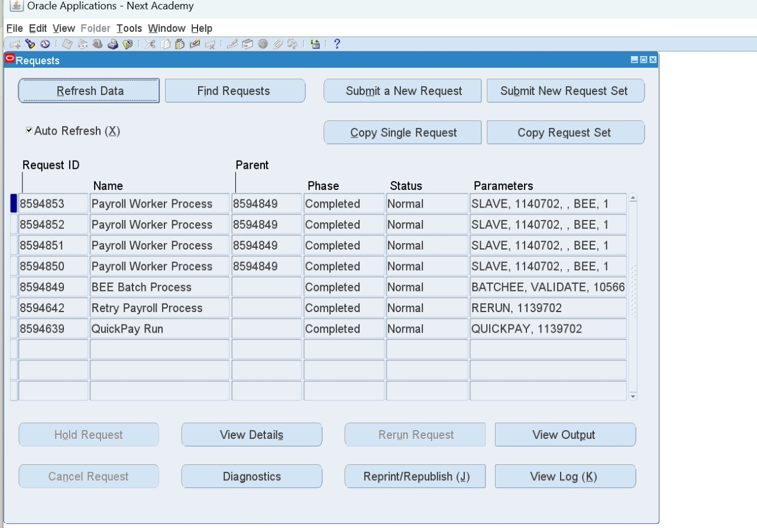
View requests to make sure running is complete

Slide 11
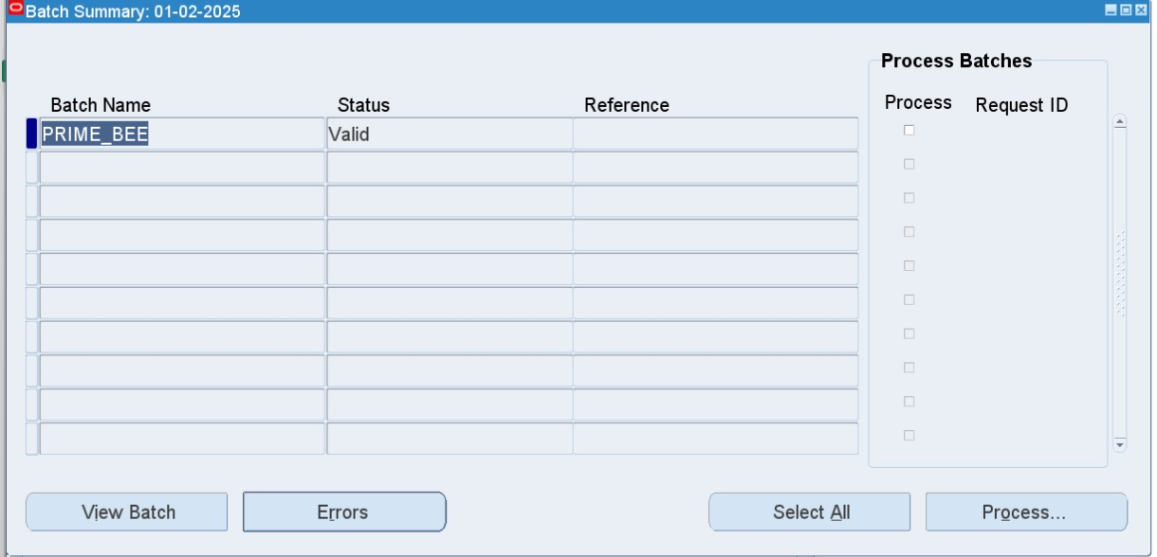
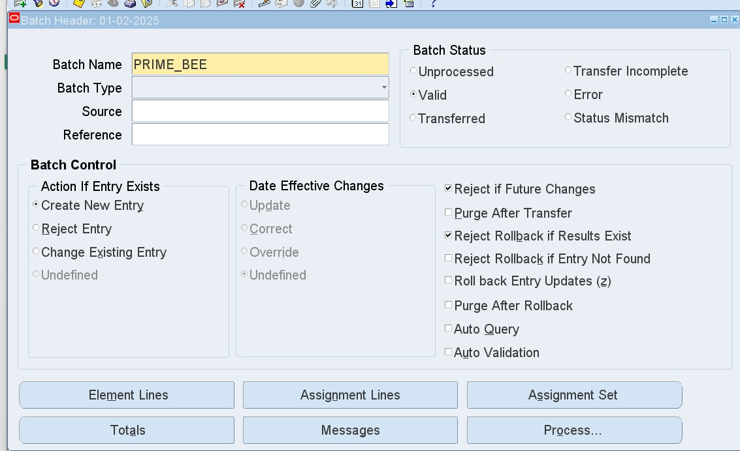
Status will be Error or Valid

Slide 12
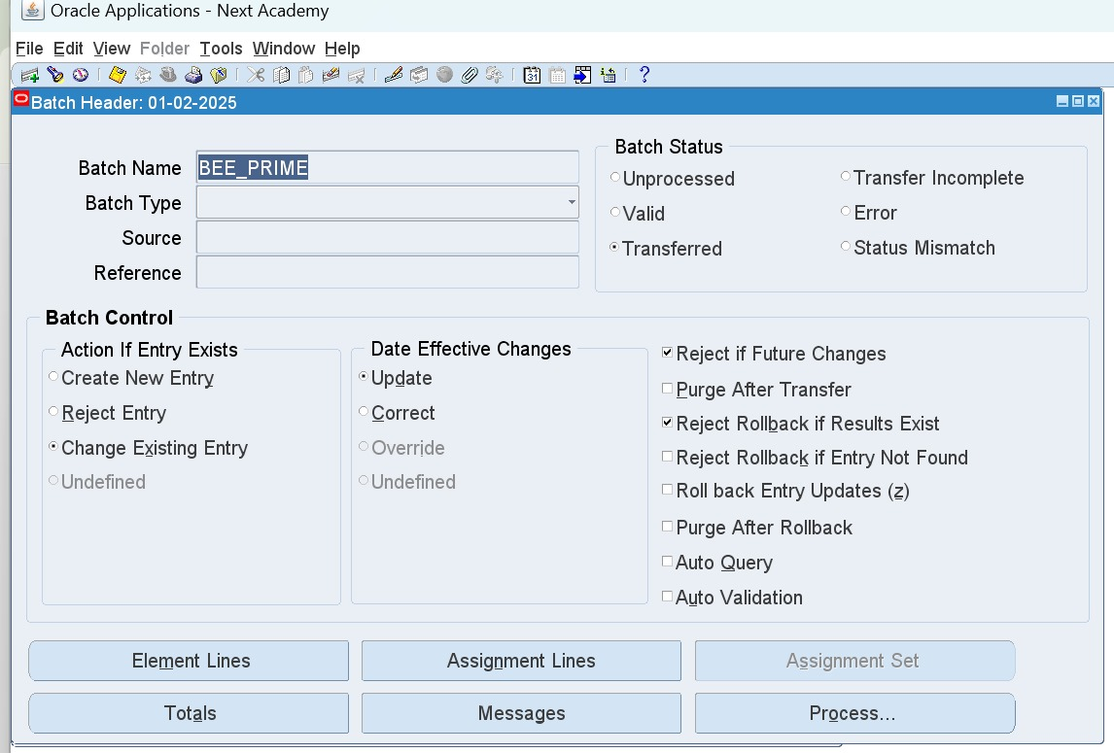
5. After status is Valid,
Process Button > Transfer
Status will be Transferred - this means the element is already reflected in Entries window for each added employee

Slide 13
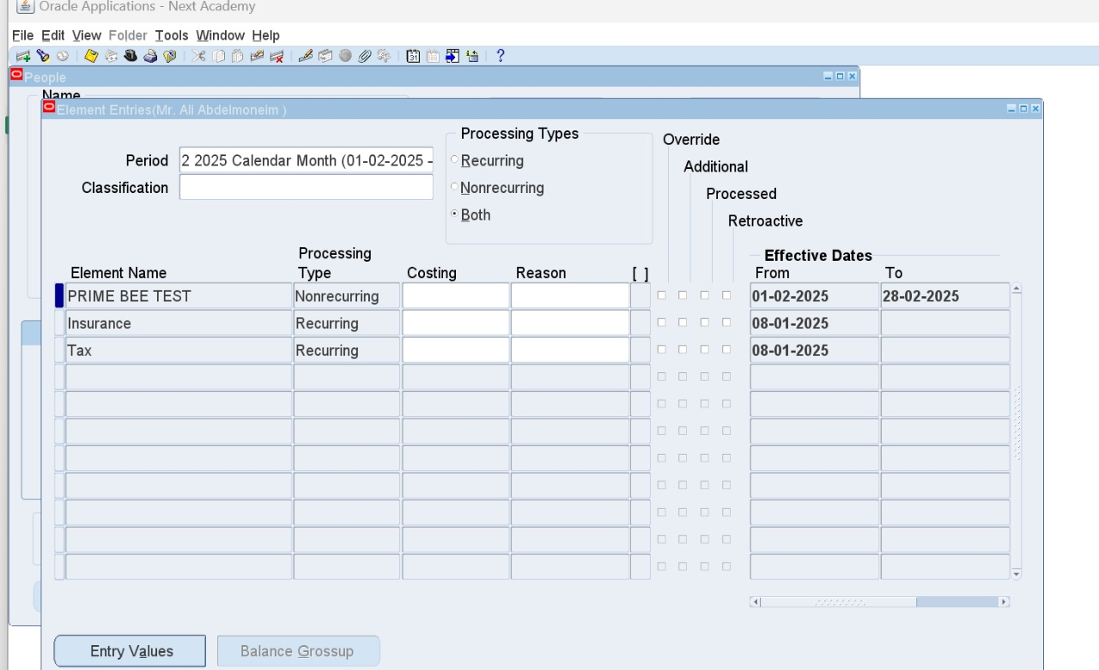
Check element entries for selected employees

Slide 14
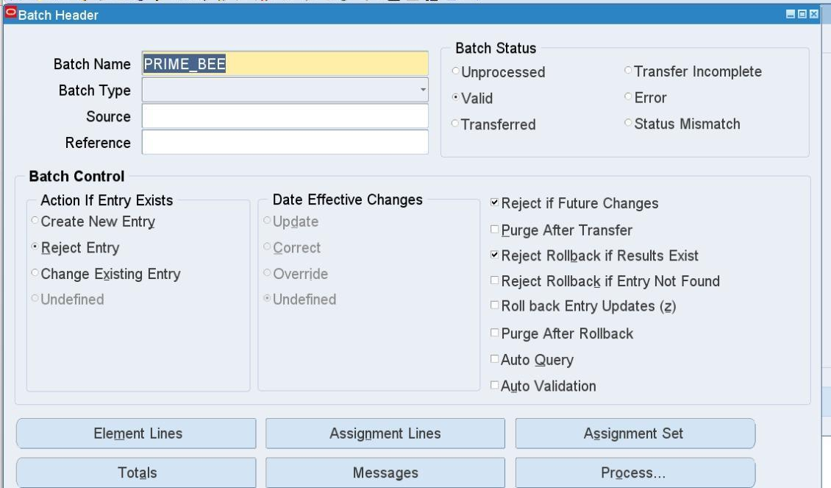
B. Reject Entry:
Reject entry if already exists (for each employee separately)

Slide 15
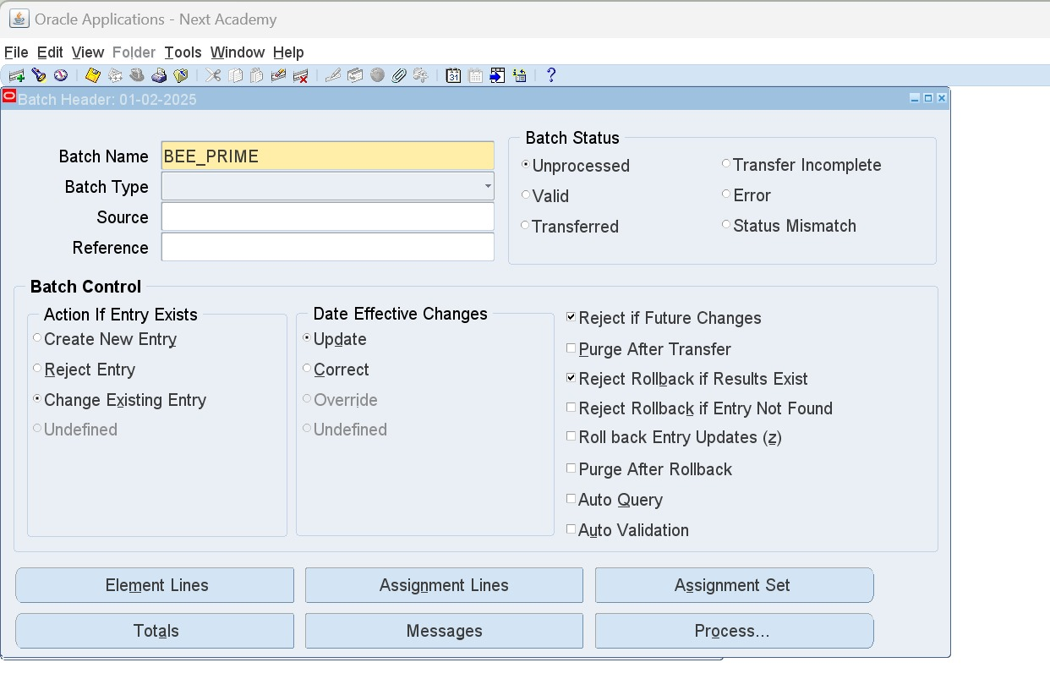
C. Change Existing Entry:
Changes element value. Date Effective Changes should be specified

Slide 16
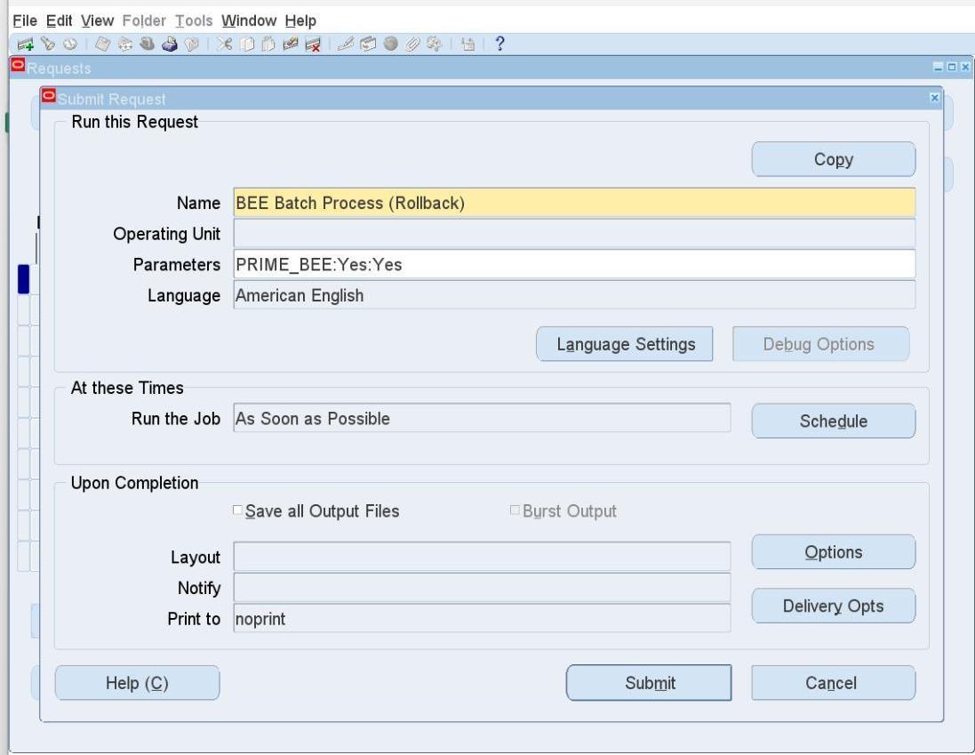
Rollback Request to cancel the BEE
HRMS > View > Requests
Name: BEE Rollback
Parameter: BEE Name
Status will return to Unprocessed, and element will be deleted from people's Entries window.

Slide 17
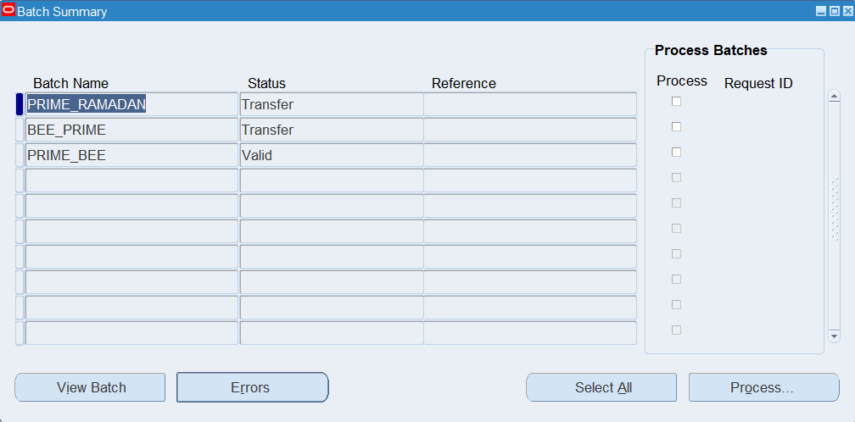
BEE Summary
HRMS > Mass Information eXchange MIX > BEE Summary
Ctrl + F11 to display data

Slide 18
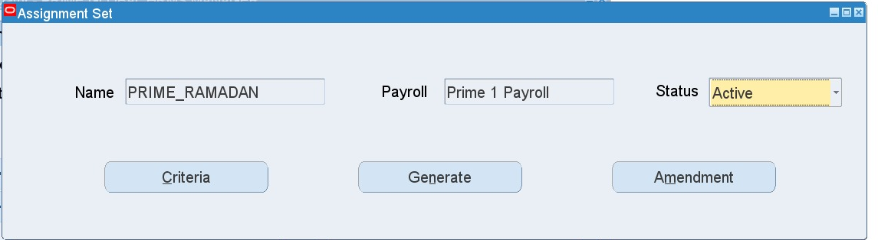
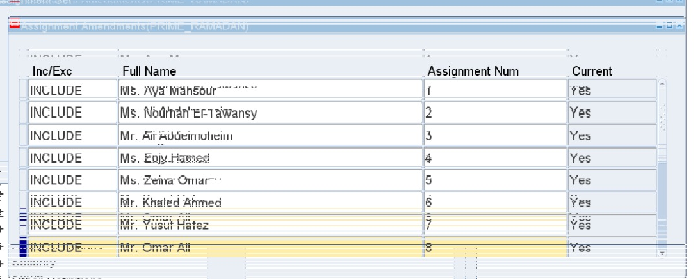
Steps to enter “One Element” )same value) to “Many Employees”
1. Create Assignment Set:
HRMS > Payroll > Assignment Set
Amendment button to add employees

Slide 19
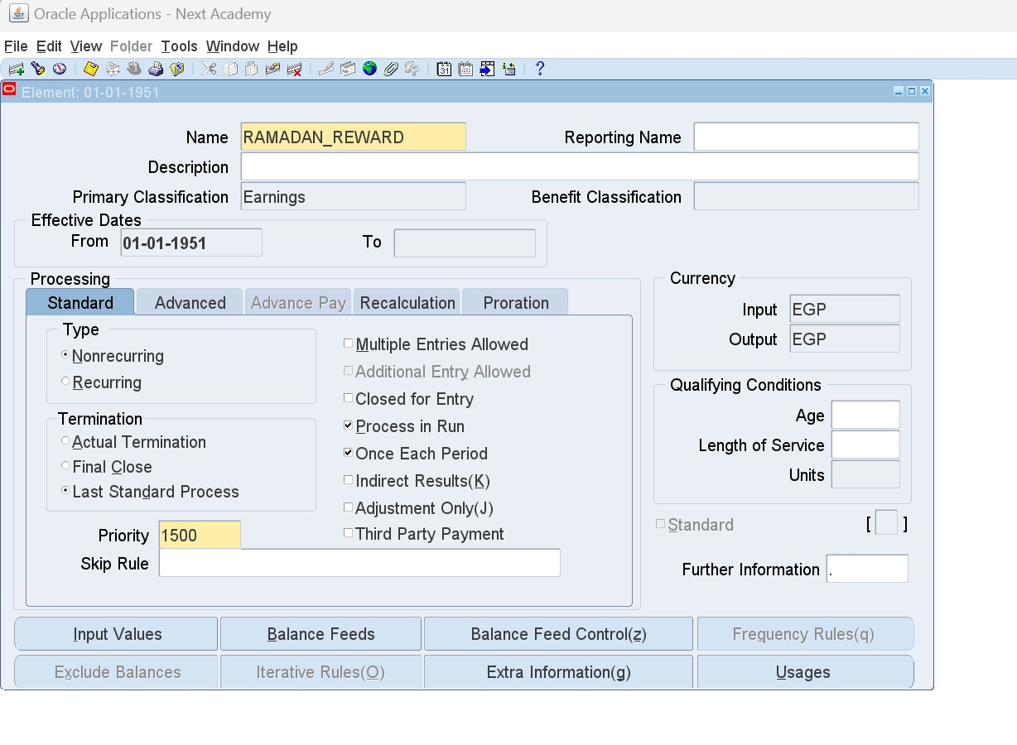
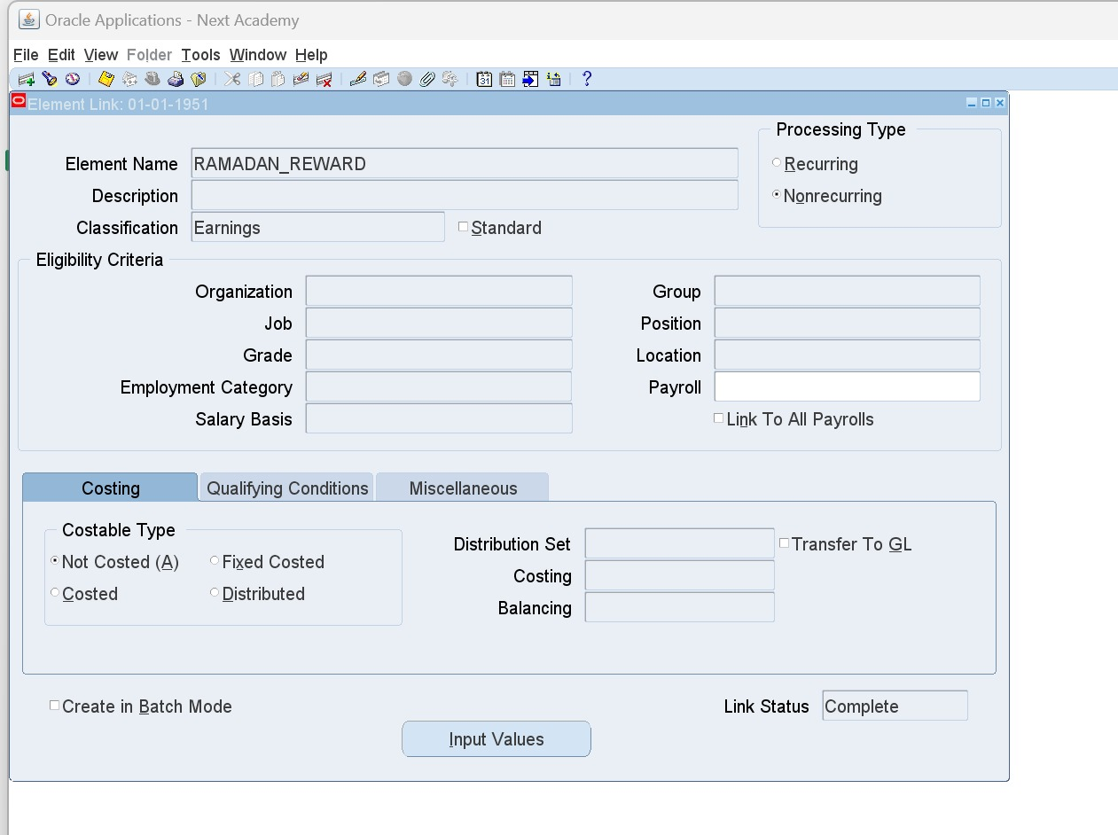
2. Create a non-recurring element and element link:
HRMS > Total Compensation > Basic > Element Description
HRMS > Total Compensation > Basic > Link

Slide 20

3. Create Batch Element Entry (BEE):
HRMS > Mass Information eXchange MIX > Batch Element Entry
Press on Assignment Set

Slide 21
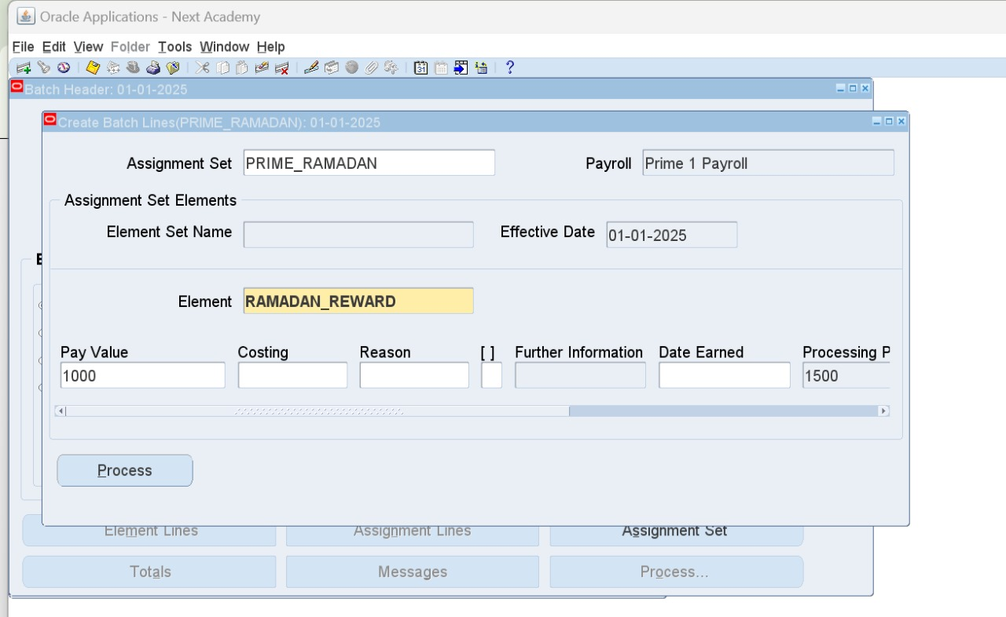
Assignment Set window to choose:
Assignment Set
Payroll Name
Element Set or Element
Add Value in Pay Value field
4. Process Button > Choose Validate
(Messages Button to review any errors)
5. After status is Valid, Process Button > Transfer

Slide 22

1. Payroll Run

Slide 23
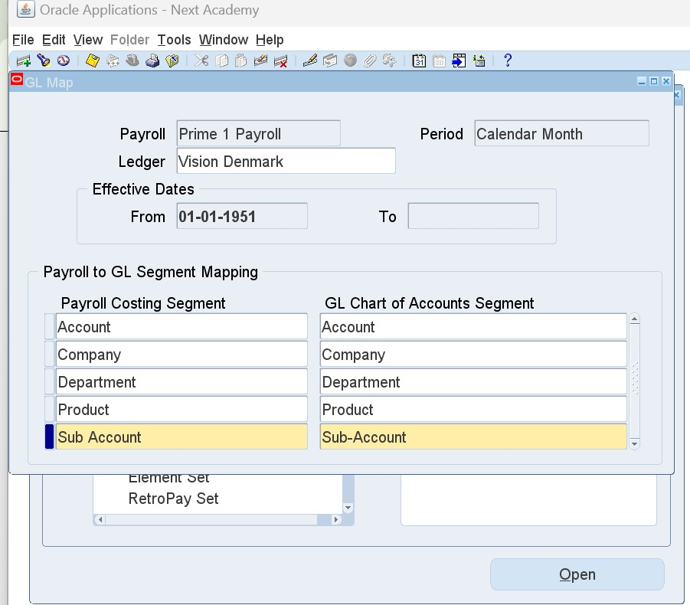
1. GL Flexfield Map
HRMS > Payroll > GL Flexfield Map
Ctrl +F11 to find my payroll
Ledger (Financial)
A. Payroll Costing Segment:
(Segments of Cost Allocation Flexfield)
B. GL Chart of Accounts Segment
(Segments of Accounting Flexfield)

Slide 24
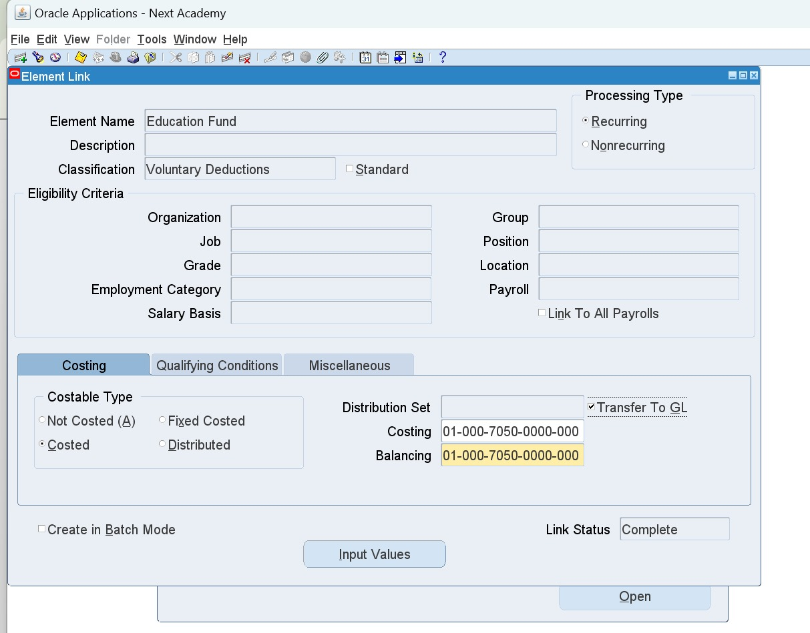
2. Costing
Create an element and element link:
HRMS > Total Compensation > Basic > Element Description
HRMS > Total Compensation > Basic > Link
While linking the element, check Costed and fill out Costing and Balancing flexfields
Both should be the same

Slide 25
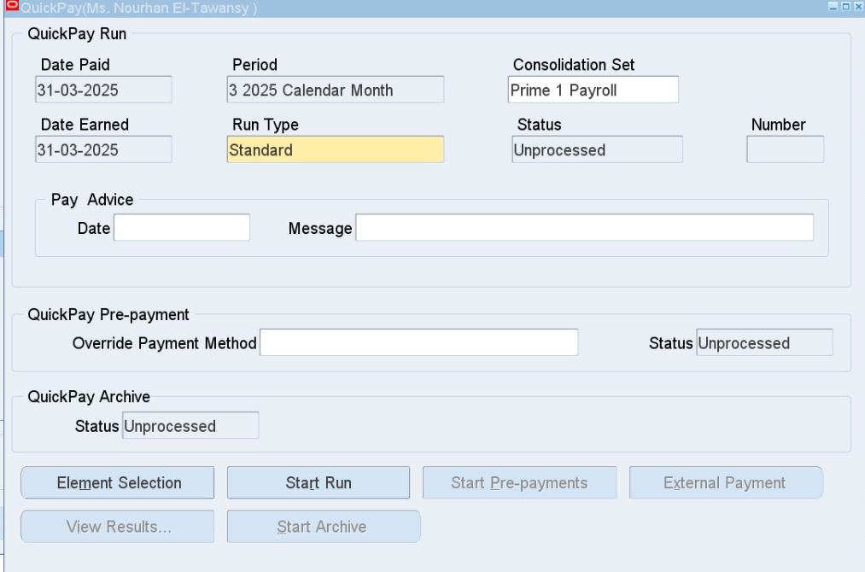
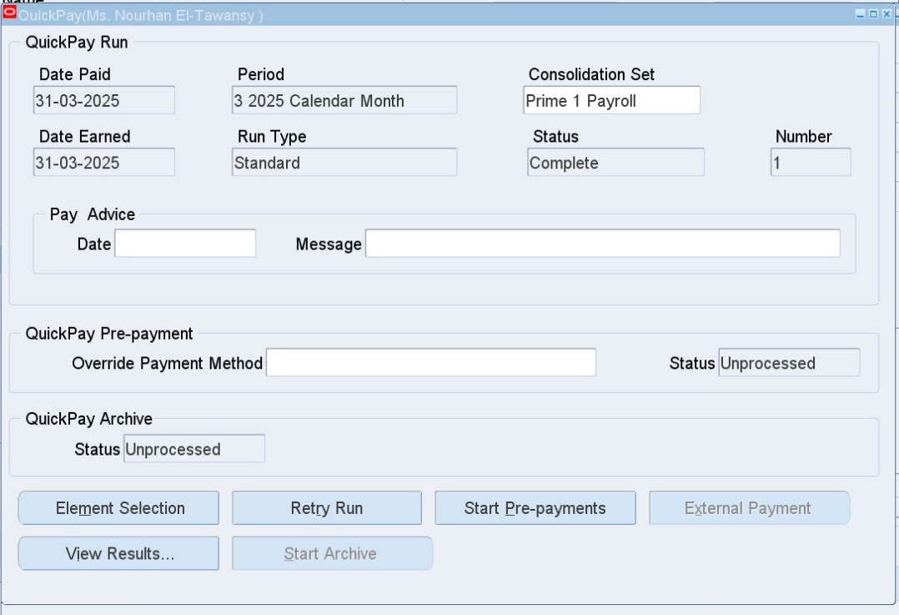
3. Pre-payment (Quick Pay)
To be run for one employee
HRMS > People > Enter and Maintain > Assignment > Others > Quick Pay
Run Type: Standard
Date Paid: Last date of the current month 31/01/2025
Start Run Button
Then
Start Pre-payments Button
Helps distribute earnings according to payment percentages setup

Slide 26
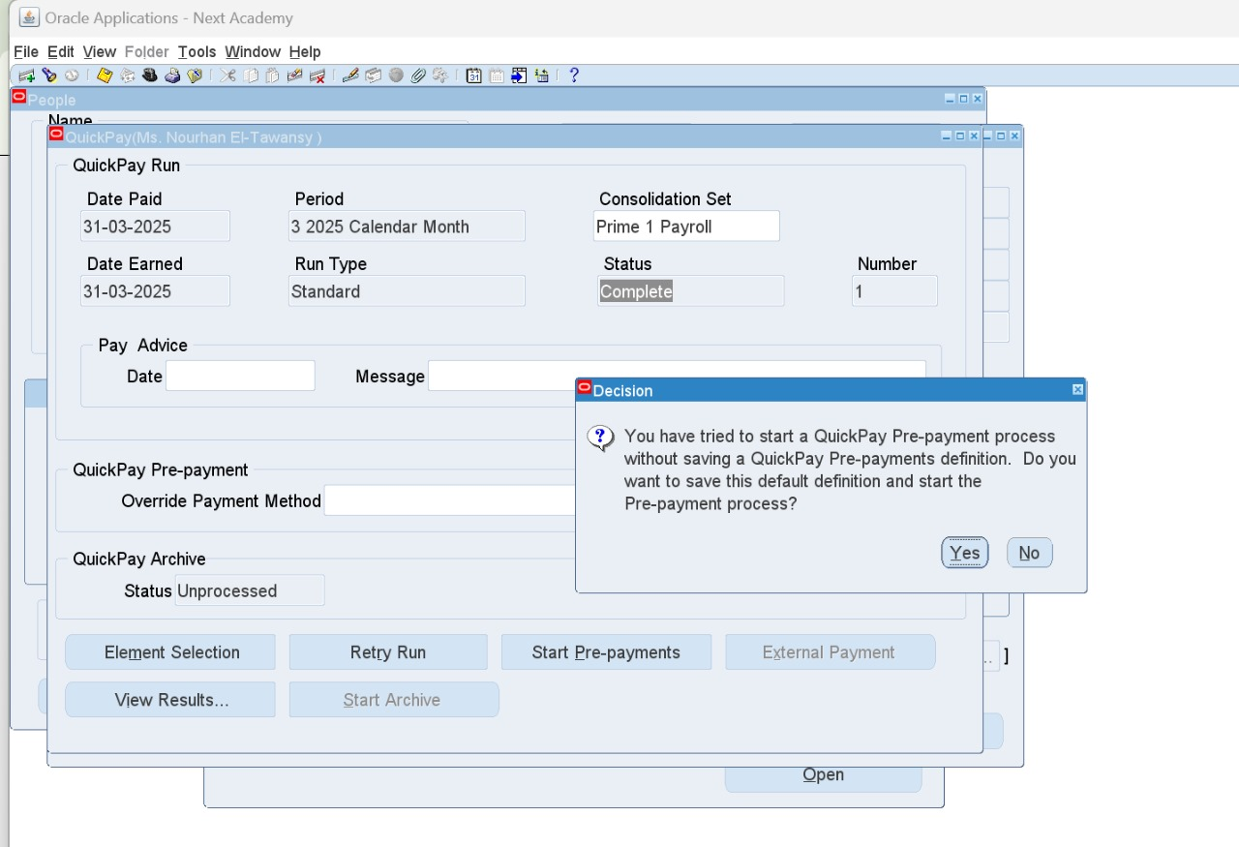
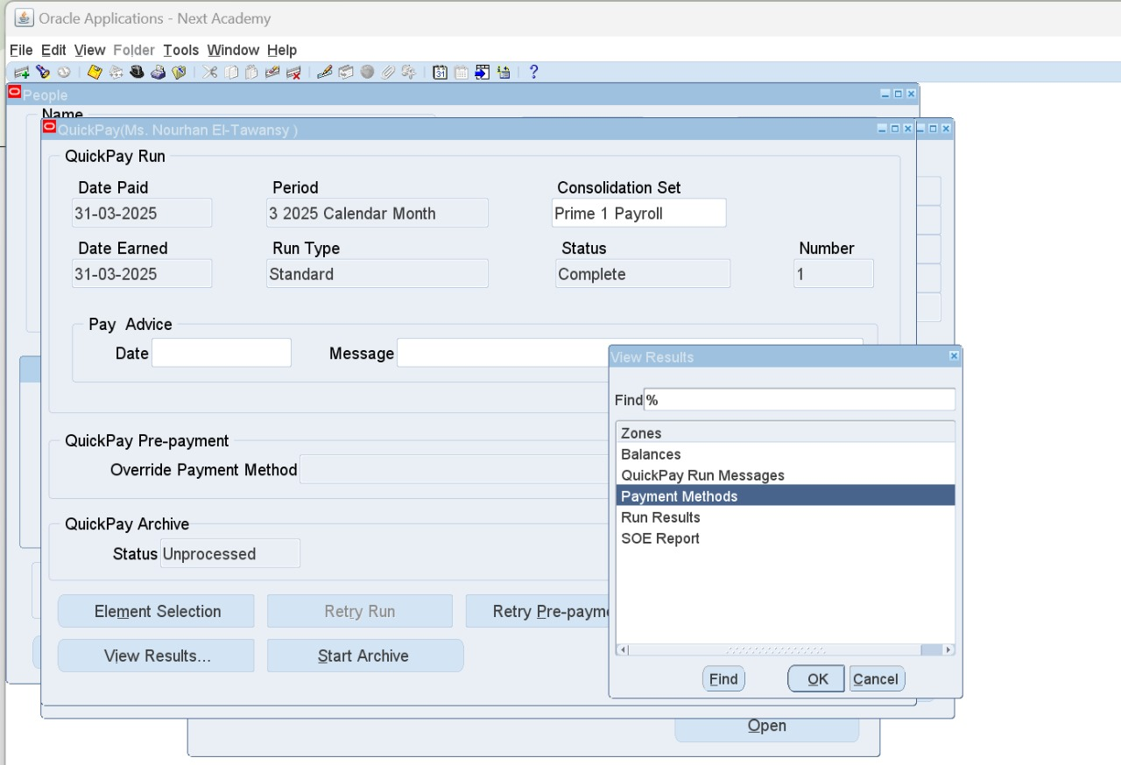
Press on View Results
Payment Methods option shows up to show the amounts distribution in case of choosing more than one payment method for the same salary.

Slide 27
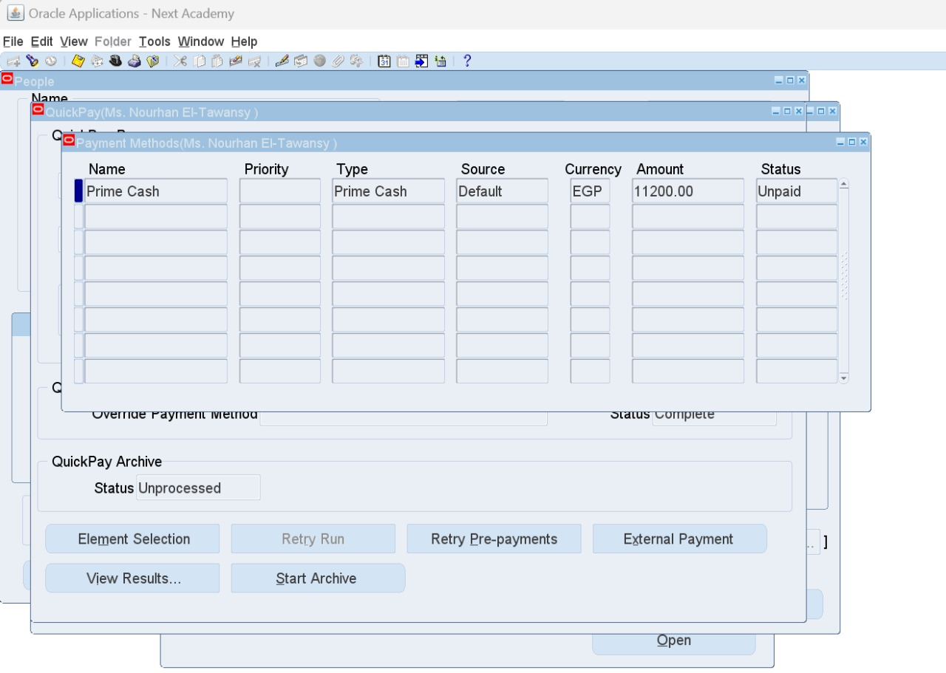
Here, we decided 100% of the salary will be paid in cash so that is the only entry we have here.

Slide 28
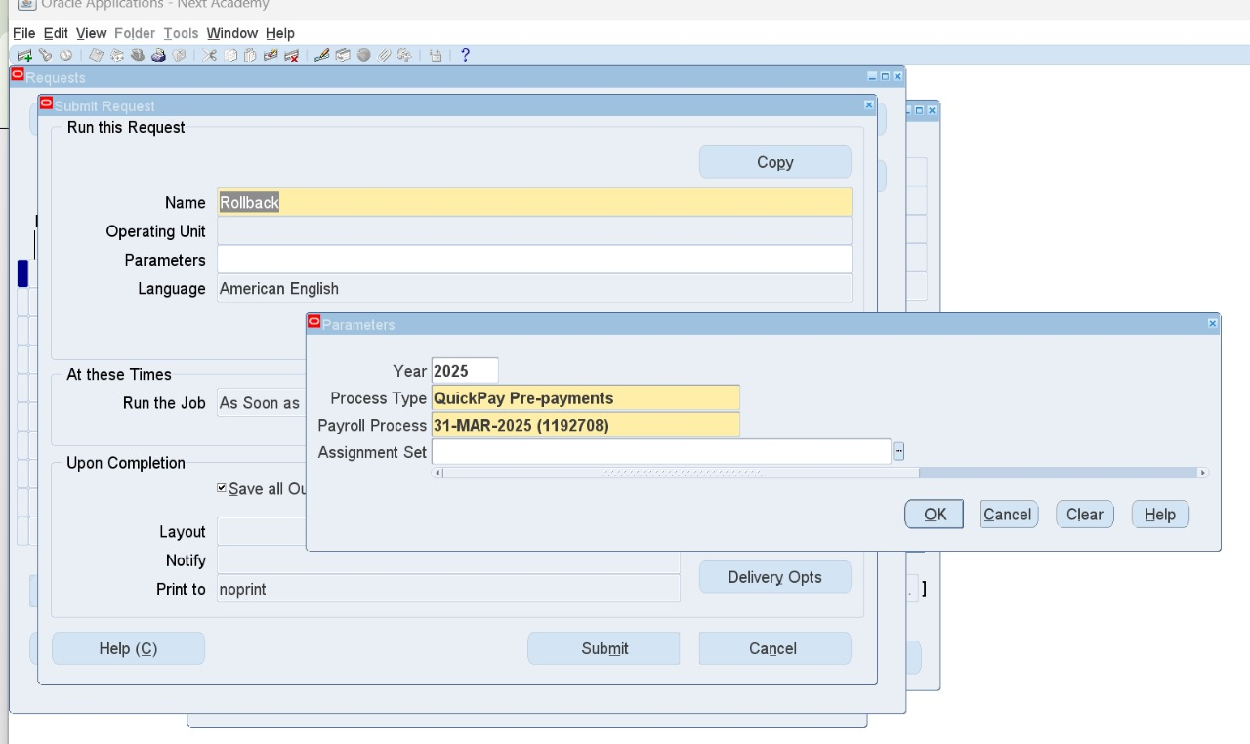
Rollback to cancel the quick pay pre-payment
HRMS > View > Requests
Name: Rollback - Parameter: QuickPay Pre-payments

Slide 29
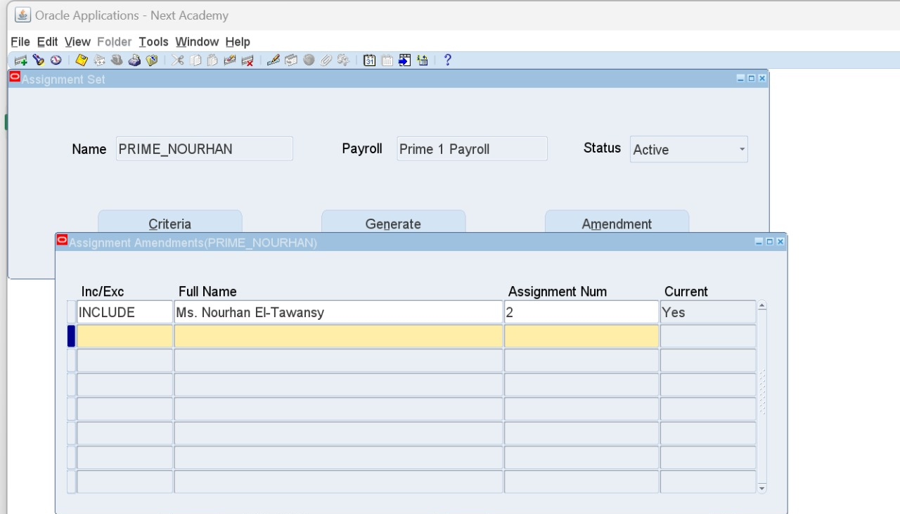
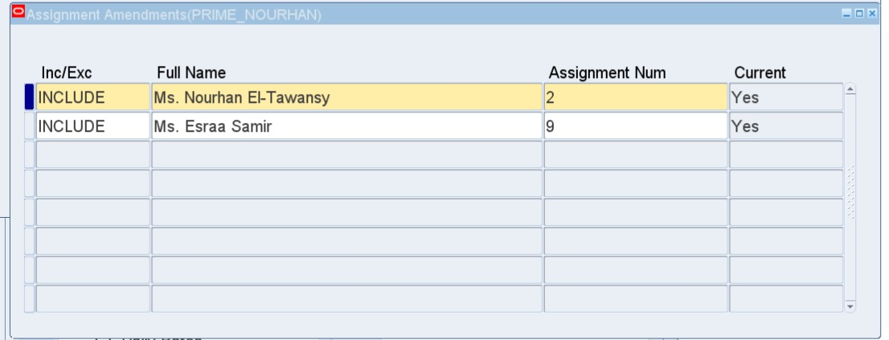
1. Payroll Run
1. Create an Assignment Set
HRMS > Payroll > Assignment Set
Name (no spaces) - Payroll – Active
Amendment Button: Add employees into the assignment set

Slide 30
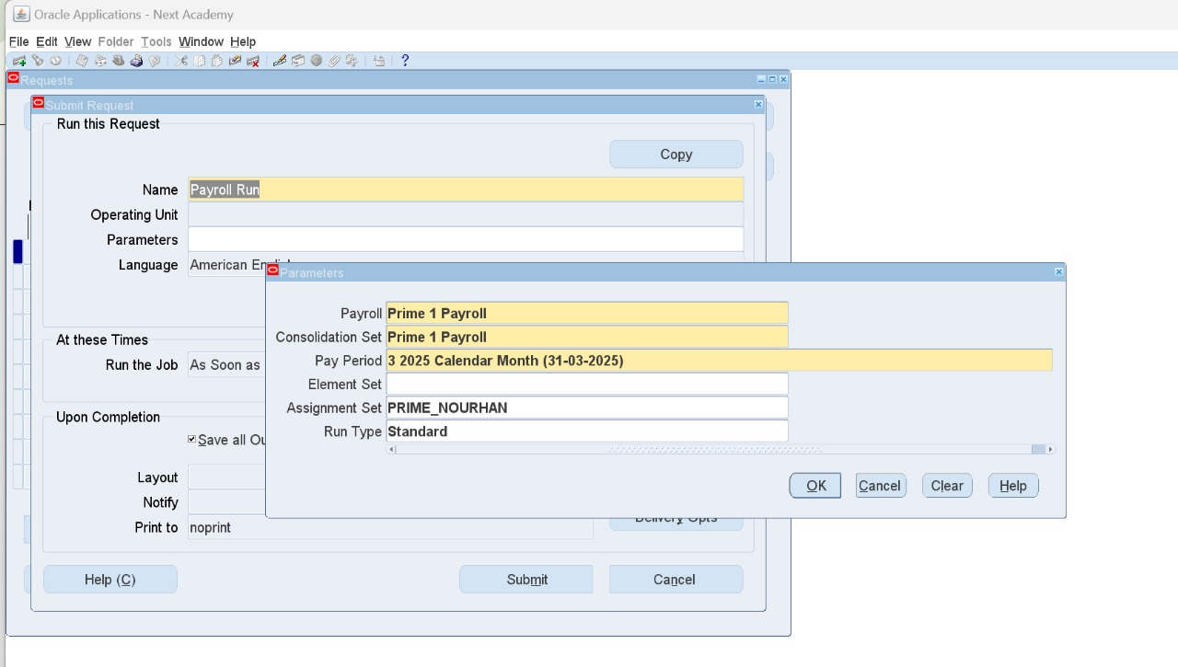
2. Run Payroll Request
HRMS > View > Requests
Fill out the parameters:
Payroll Name
Consolidation Set
Pay Period
Assignment Set

Slide 31
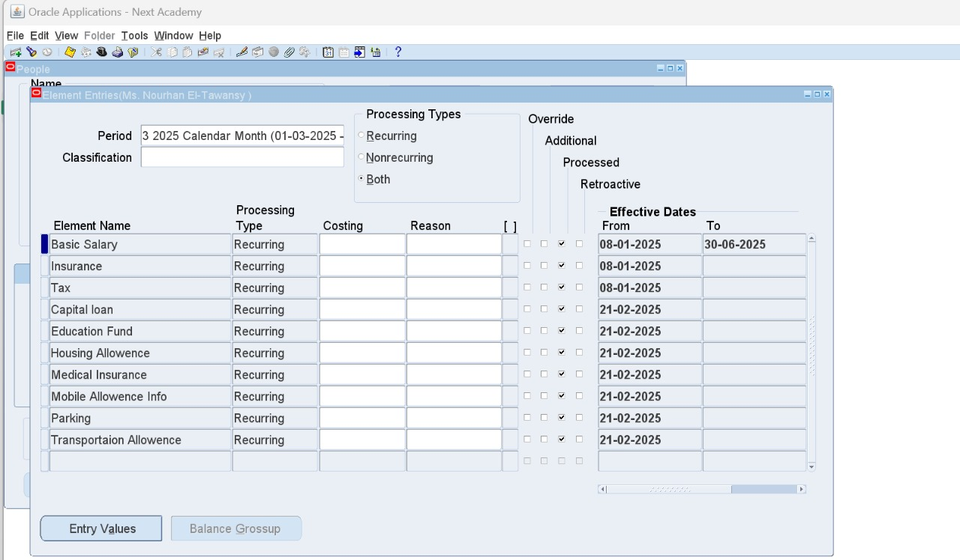
Now elements are all processed

Slide 32
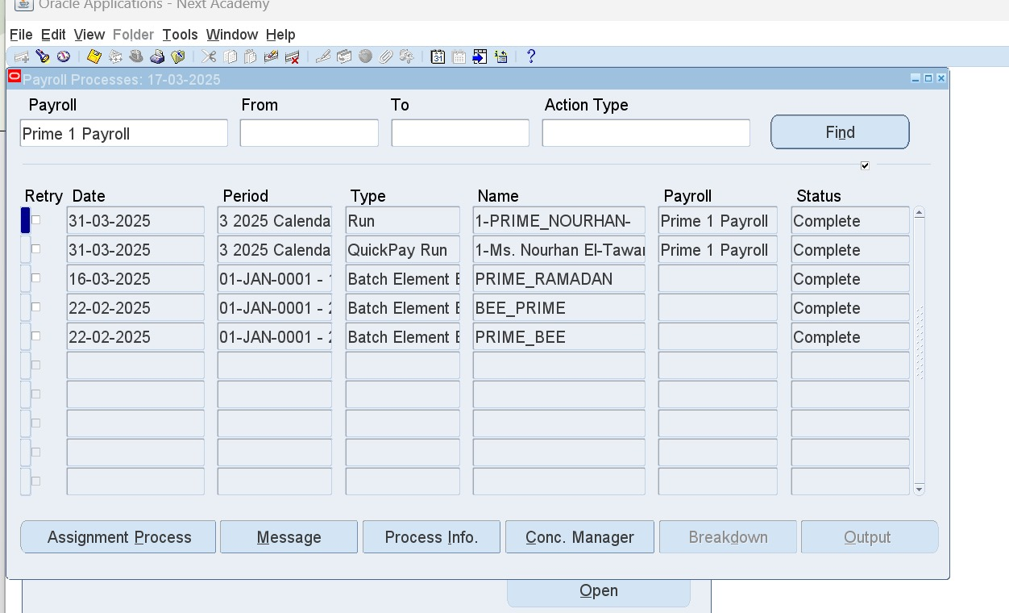
Payroll Process Results
To review payroll run results
HRMS > View > Lists > Payroll Process Results
Press on Assignment Process Button to view employees

Slide 33
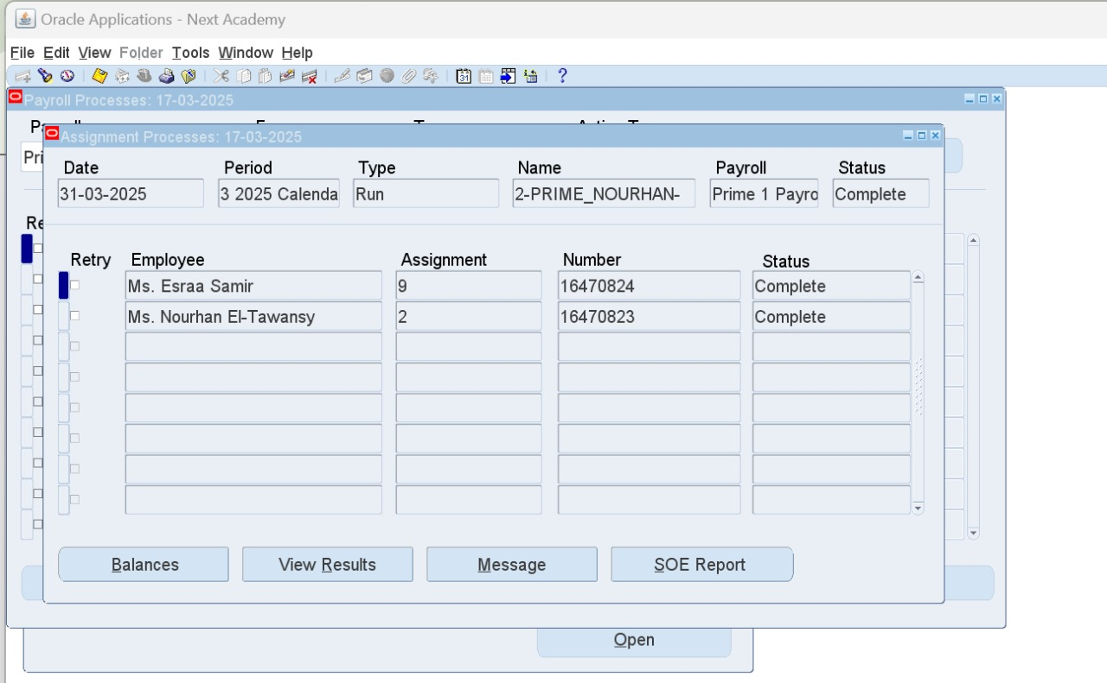

Slide 34
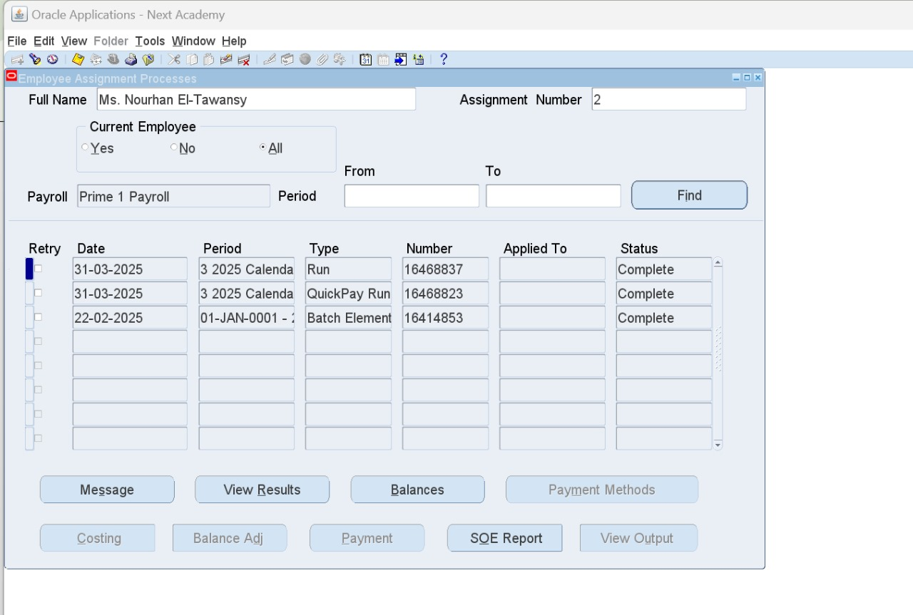
Employee Assignment Process Result
HRMS > View > Lists > Assignment Process Results
To review an employee's history

Slide 35
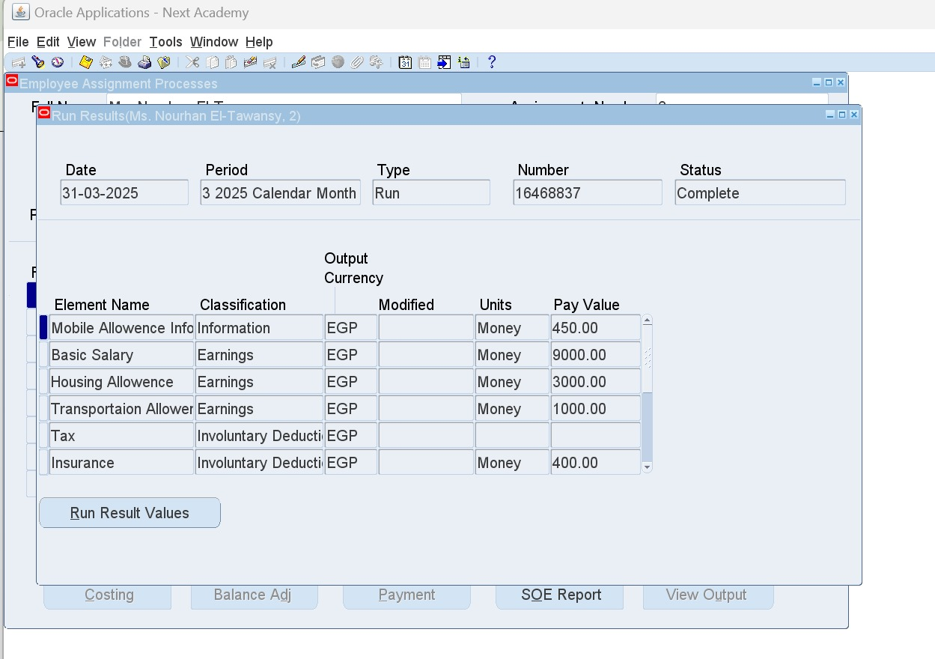
View Results Button shows the detailed display of elements

Slide 36
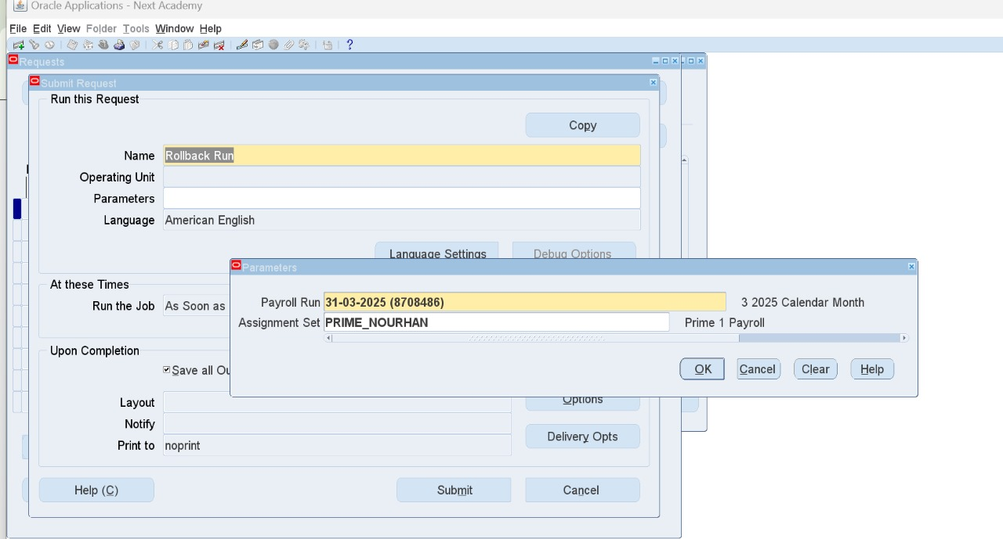
Payroll Rollback Run
HRMS > View > Requests

Slide 37
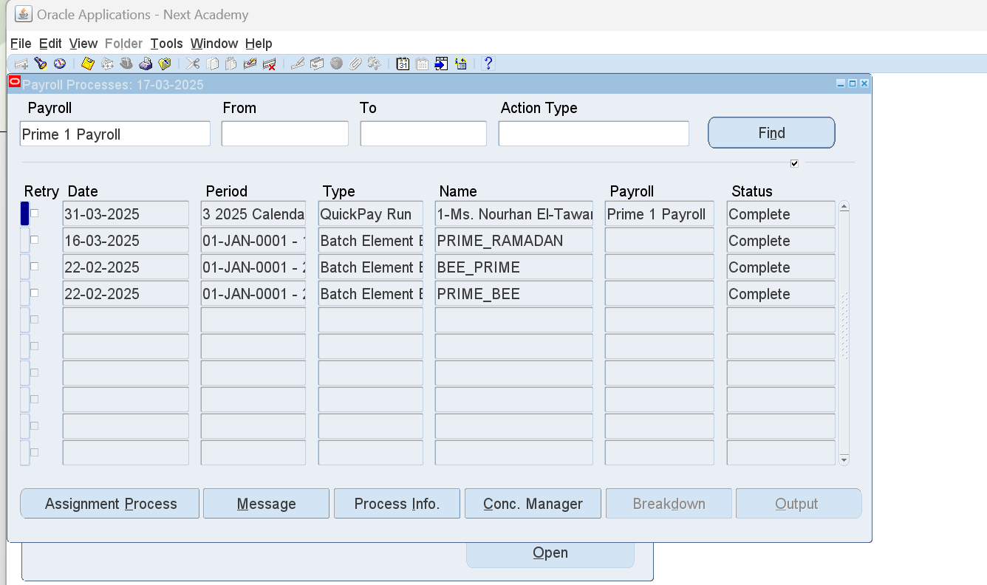
Payroll Process Results
To review payroll run results
HRMS > View > Lists > Payroll Process Results

Slide 38
Assignment Process Button displays the list of employees included

Slide 39
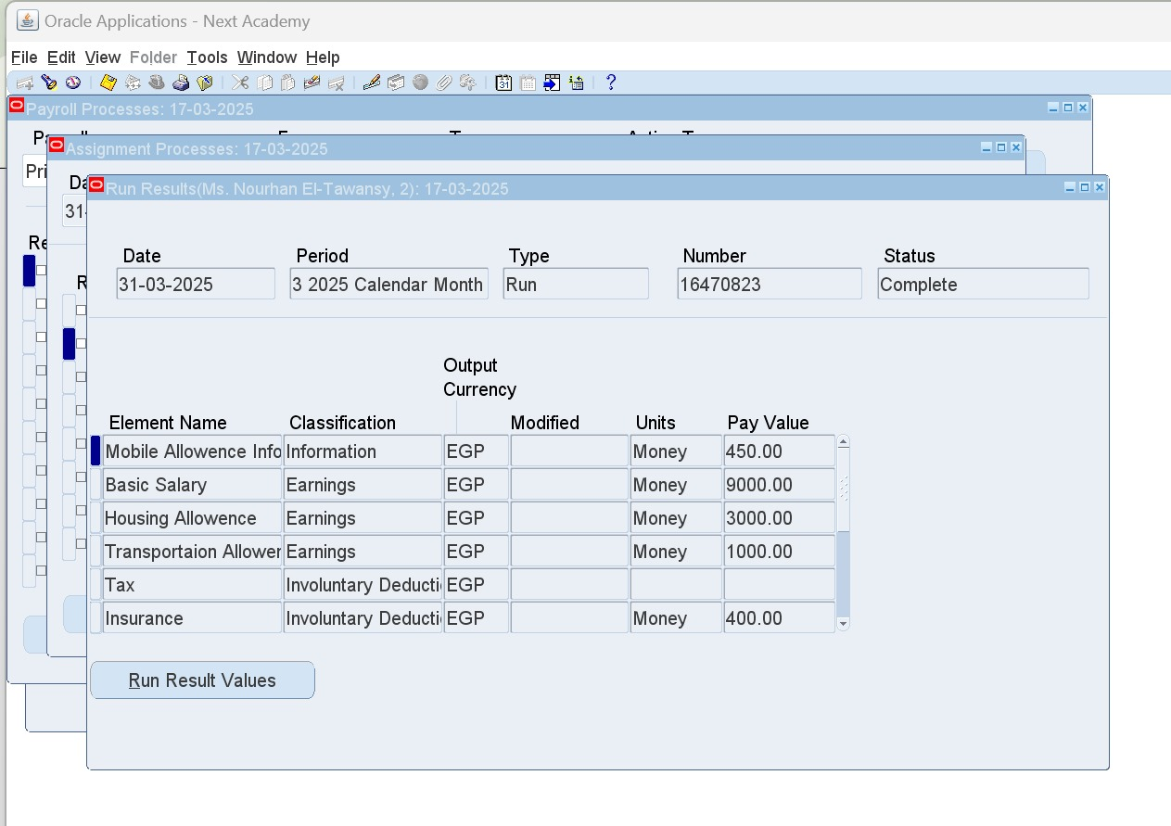
View Results Button displays the elements included

Slide 40

2. Pre-payments

Slide 41
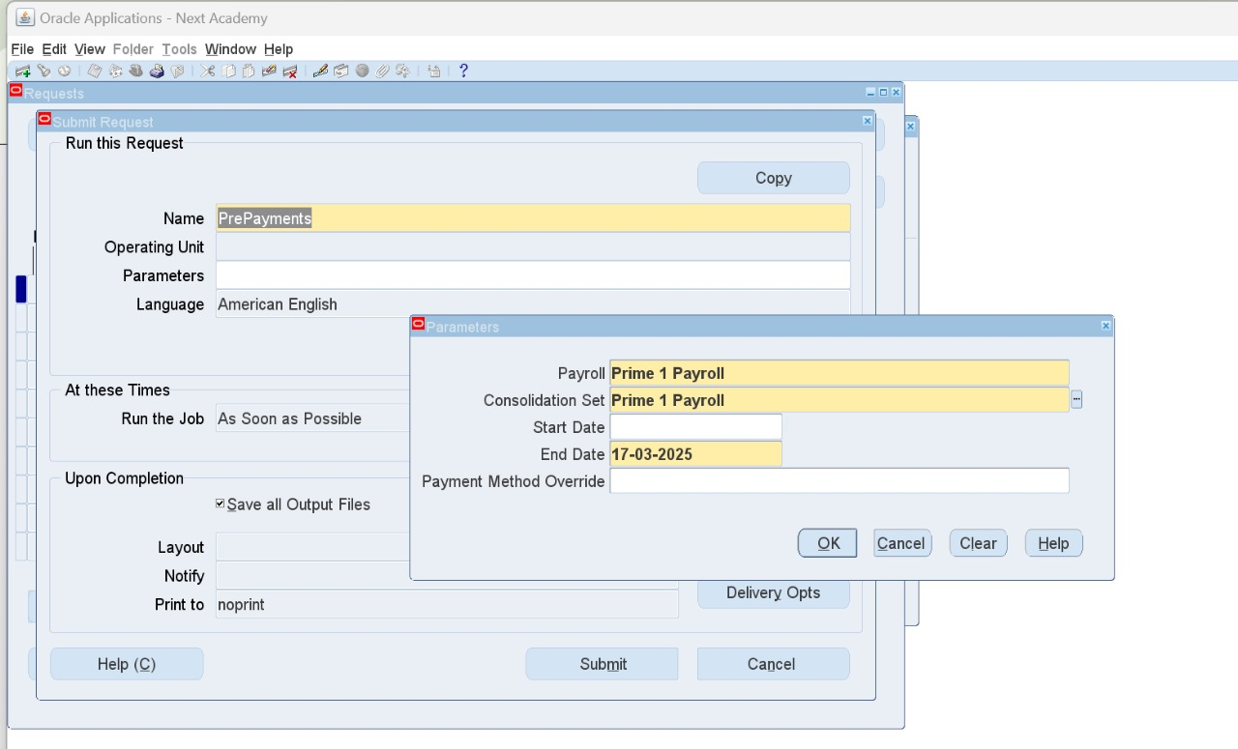
2. PrePayments
It helps distribute salary percentages for people depending on payment methods
HRMS > View > Requests
Name: PrePayments
Payment Method Override for quickpay cases.
Default method is CASH

Slide 42
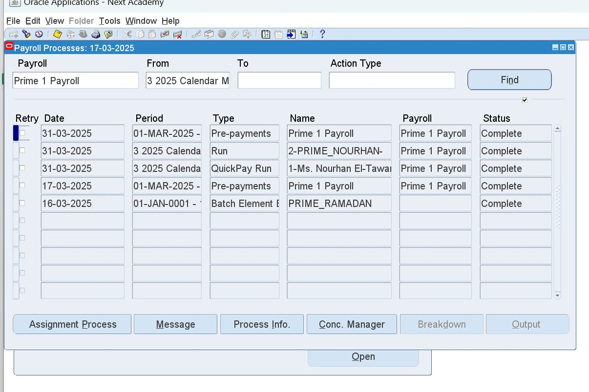
Payroll Process Results
HRMS > View > Lists > Payroll Process Results
Assignment Process button shows the included employees

Slide 43
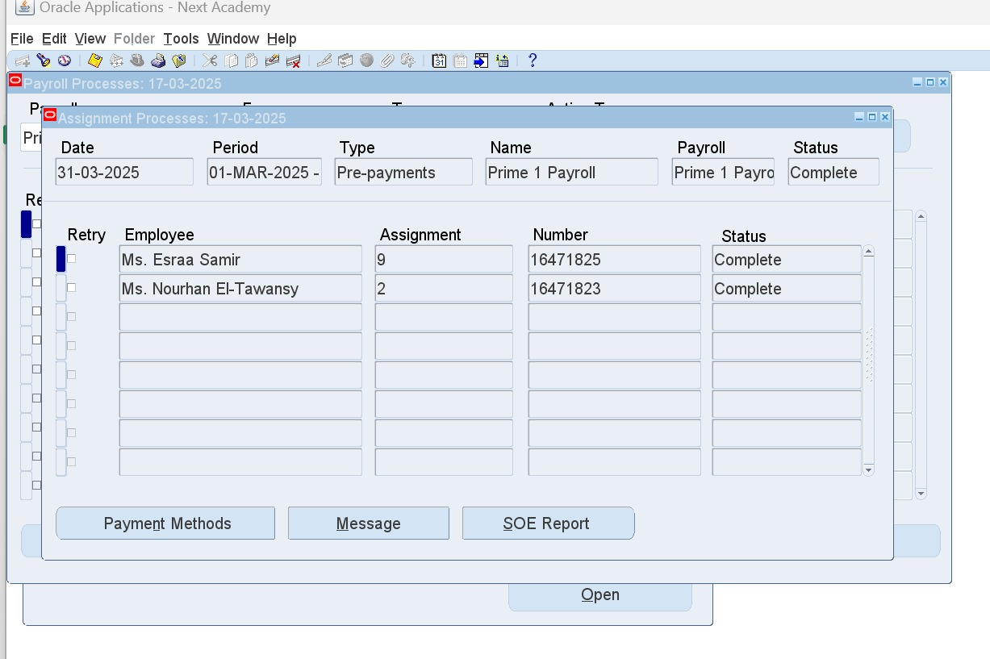
Payment Methods button shows each employee’s payment method/s and the percentage of each in case there are more than one method.

Slide 44
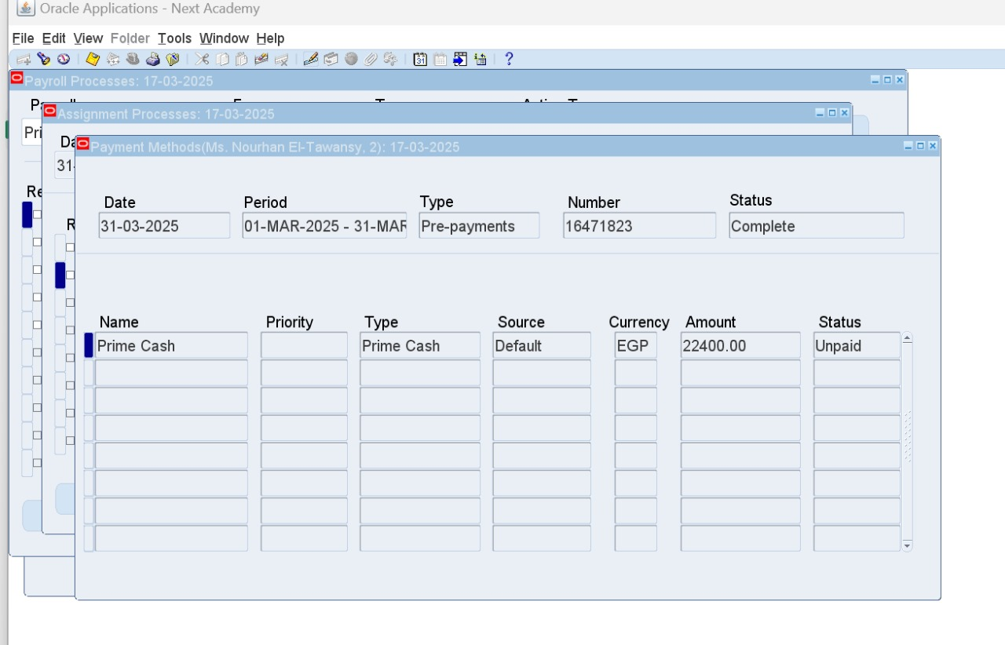
Here is only one payment method

Slide 45
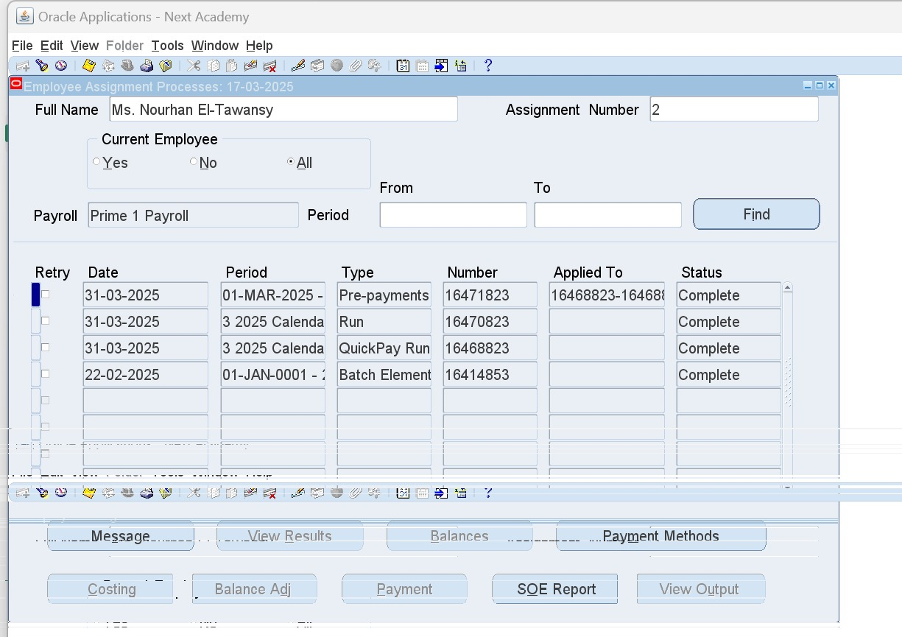
To review each employee’s history
HRMS > View > Lists > Assignment Process Results
Search for employee
Payment Methods button shows the payment methods assigned for this employee

Slide 46
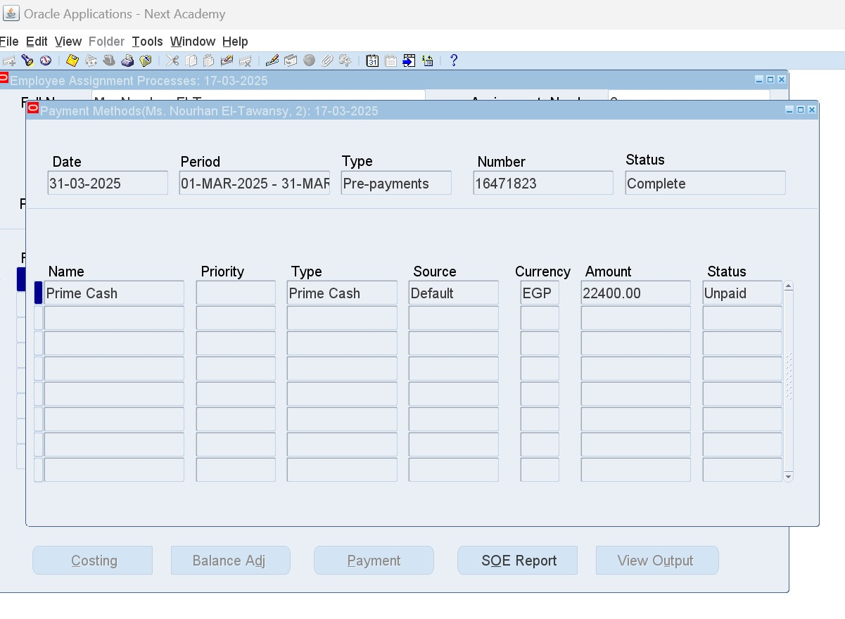

Slide 47

3. Cash

Slide 48
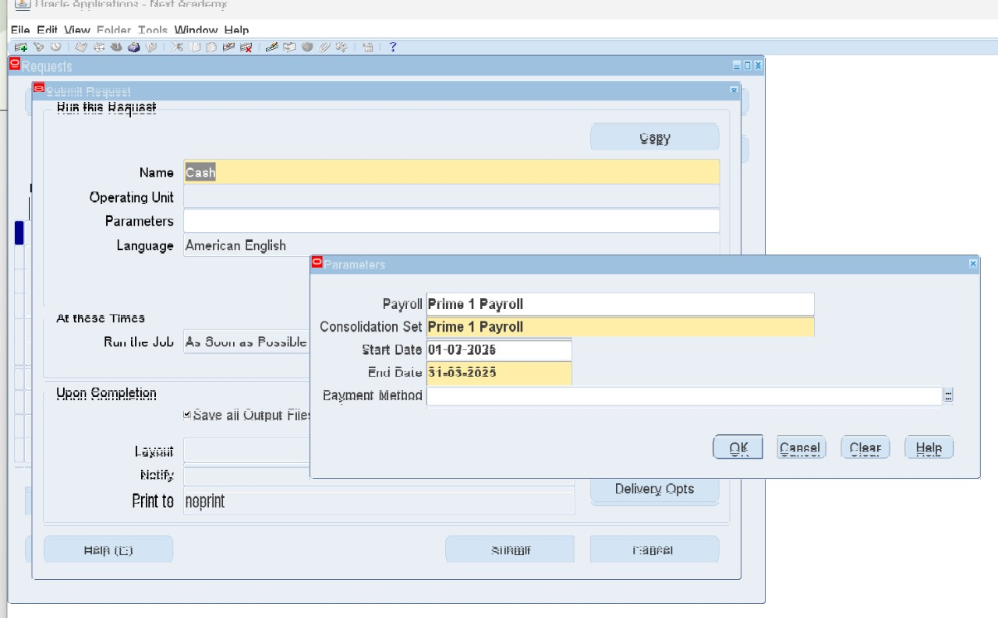
3. Cash
Submit a new request
HRMS > View > Requests
Name: Cash
After running this request, status of payment method will change from unpaid to paid

Slide 49

4. Costing

Slide 50
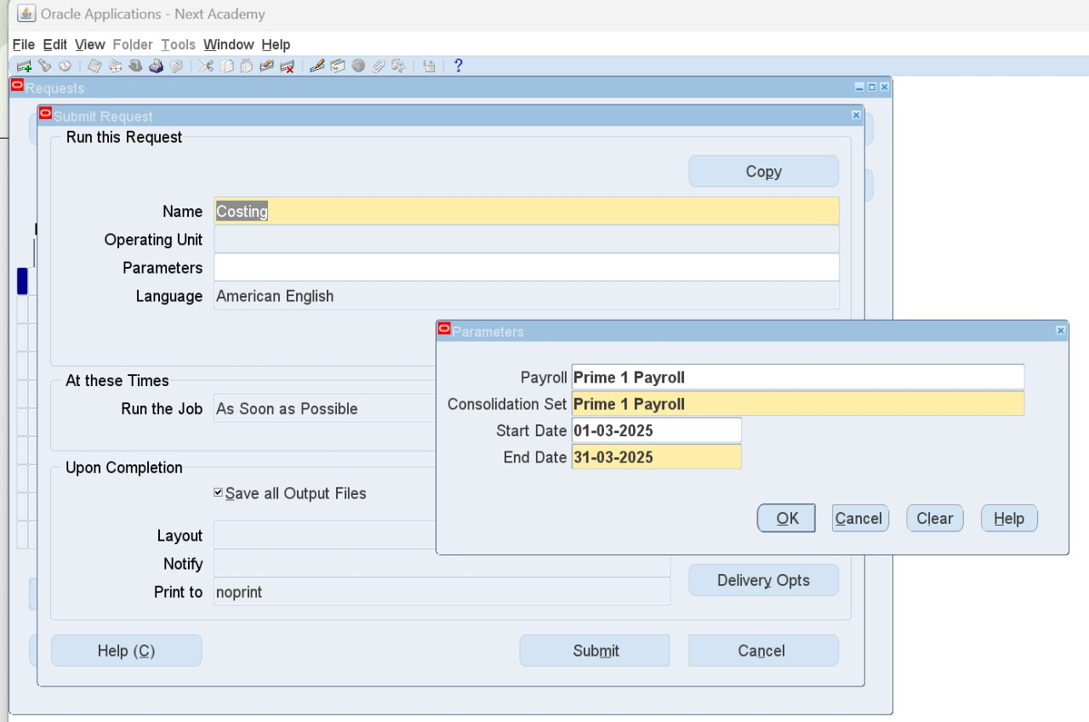
4. Costing
It helps getting elements to Financial account
Submit a new request
HRMS > View > Requests
Name: Costing

Slide 51

5. Transfer to GL (General Ledger)

Slide 52

5. Transfer to GL (General Ledger)
Submit a new request
HRMS > View > Requests
Name: Transfer to GL

Slide 53

SOE (Statement of Earning)

Slide 54

Add the needed sub-menus
System Administrator (N) > Application > Menu
Query your used menu and add these sub-menu and function:
“Global HRMS Statement Of Earnings” to enable the SOE form-based (Sub-menu)
“Online Statement Of Earnings” to enable the SOE web-based (Function)

Slide 55

“Global HRMS Statement Of Earnings” to enable the SOE form-based (Sub-menu)
“Online Statement Of Earnings” to enable the SOE web-based (Function)

Slide 56

2. HRMS > Other Definitions > Application Utilities Lookups
Type: SOE_USER_CATEGORY
Create a new User Category Code for your Business Group

Slide 57

3. Link the new User Category Code to the Payroll Responsibility, or to the Site level
System Administrator (N) > Profile > System
PAY:Statement of Earnings User Category

Slide 58


Slide 59

4. Create 3 Element Sets for:
Earning
Deduction
Information
Type is Customization Set
HRMS > Payroll > Element Set

Slide 60


1. EARNING
All earning elements shall be automatically added.
Choose what to include from Classification Rules button

Slide 61


Slide 62


2. DEDUCTION
This should include both voluntary and involuntary deductions.
Choose what to include from Classification Rules button

Slide 63

3. INFORMATION
(Those that had a Reporting Name while creating the element)
Choose what to include from Classification Rules button

Slide 64

5. Query your BG
HRMS > Work Structure > Organization > Description > Others Button > SOE Information

Slide 65

Enter this data
. User Category: select the new created User Category
. Elements 1: select the Earning Elements Set
. Elements 2: select the Deduction Elements Set
. Information 1: select the Information Elements Set
. Balance 1: select ONLINE_SOE_BALANCE_ATTRIBUTE

Slide 66

6. Query your BG
HRMS > Work Structure > Organization > Description > Others Button > SOE Detail Information
Add all information elements

Slide 67

To display SOE Report
HRMS > View > Lists > Assignment Process Results
SOE Report button opens a web page for review

Slide 68
THANK YOU!

